Slide 1
Handwriting recognition system for symbols
Group 1
Notes:
Welcome.
We are group 1. Our project is about “Handwriting recognition system for symbols”.
The system will help the carpenters to translate their drawings on their work piece into a digital instruction set.
The interactions with these digital workflows will help the carpenters more efficiently.
In the next slide we will show the carpenter workpiece, a wooden piece with their drawings.

Slide 2
Task and Time Plan
Week 1 | Week 2 | Week 3
Define project plan | Implement the different CNN models and use different approaches fx. Transfer Learning | Final evaluation of models on validation set
Create dataset | Optimize model performance by altering parameters | Write report
Augment data | Train models on data-set | Final presentation
Research CNN models

Slide 3
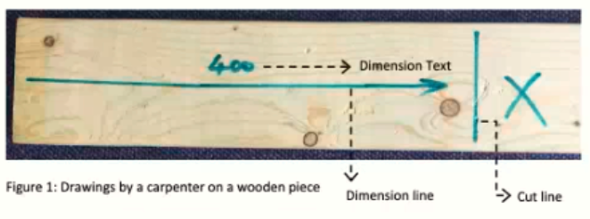
Project Goal
The main project goal is to implement a system which can translate the carpenters drawings into a digital instruction set.
The system will be developed as the following sub goals:
Explore the applications of neural networks and computer vision algorithm to detect engineering symbols on Timber(a carpenter's work piece) as shown in figure..
Identify the symbols and the information it contains.
Read cut-line dimensions
Identify the piece which needs to be cut
Notes:
The main goal is to develop a system that can translate the carpenters drawings into a digital instruction set.
Using the neural networks and computer vision algorithm, we will extract and classify
the symbols for cut lines and symbol for pieces which would be discarded.

Slide 4
Evaluation/Test Plan
Annotate the full data-set
Standard Machine Learning approach of dividing the data-set into a training and test set (train-test-split).
The training set is then used to train the best possible model and the test set is used to test the prediction accuracy of the model.
An example is keeping 30% of the data for testing and using 70% to train the model.

Slide 5
Risk Analysis
In general a CNN-models performance improves with a larger data-set. So when we only create a small sample, then it might not include all the deviations.
The data-set is build on the handwriting from 3-4 people and may not be representative for the carpenter industry.
By using data augmentation and other approaches, we hope to minimize these risks and don’t let them affect the performance of the models.

